Slide 1
Spatiotemporal dynamics and seasonal trends of dengue cases and related mortality in Bangladesh (2020–2023)
Presenter: Moumita Jhara

Slide 2
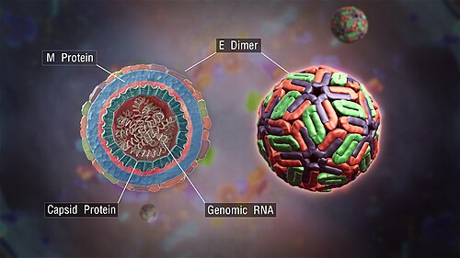
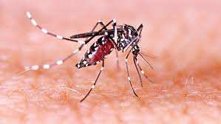
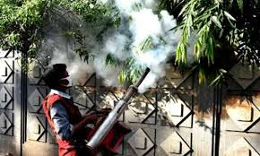
Background
The disease is transmitted by Aedes aegypti and Aedes albopictus mosquitoes
Dengue was first documented in Bangladesh in the 1960s
The first major outbreak in 2000
Major Outbreaks:
2019: Over 100,000 hospitalizations and 266 deaths
2023: The deadliest outbreak to date, with 321,179 hospitalizations and 1,705 deaths

Slide 3
Objectives
Generate a choropleth map using R to visualize the geographic distribution of dengue cases across districts
Time series plots to examine seasonal fluctuations
Perform age-specific comparisons of dengue cases and deaths to show distribution of cases and deaths by age group
Assess gender-specific differences in both dengue incidence and fatality
Chi-square tests to evaluate statistical significance

Slide 4
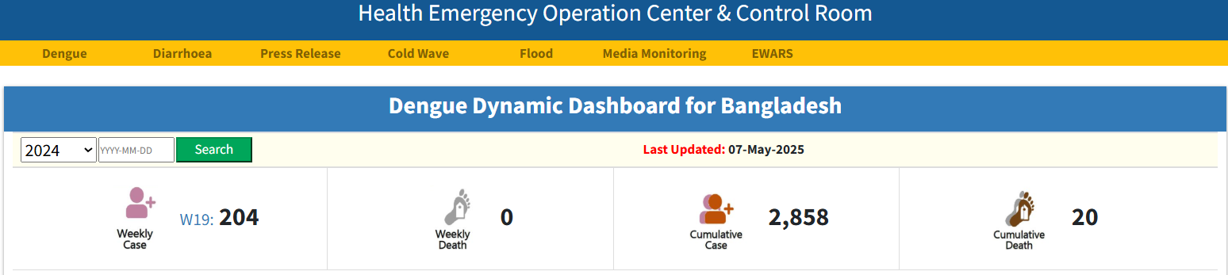
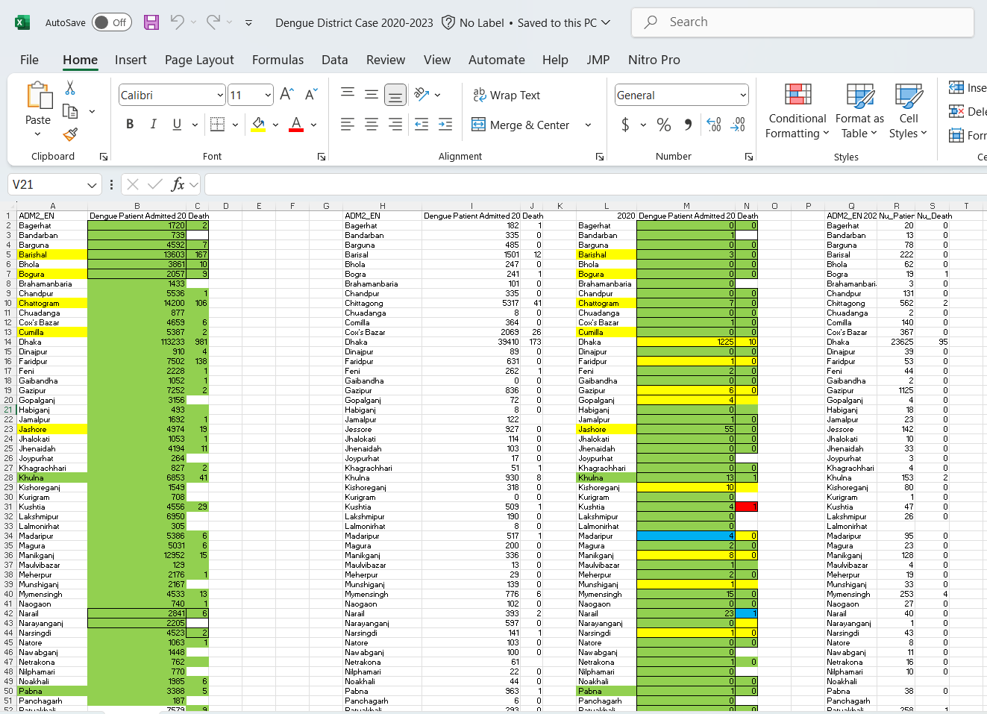
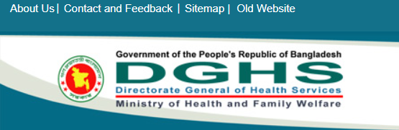
Data Sources

Slide 5
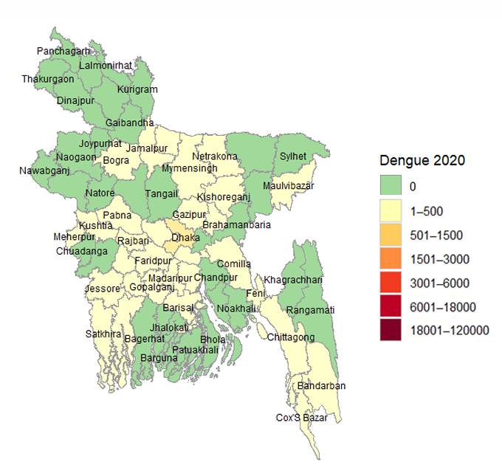
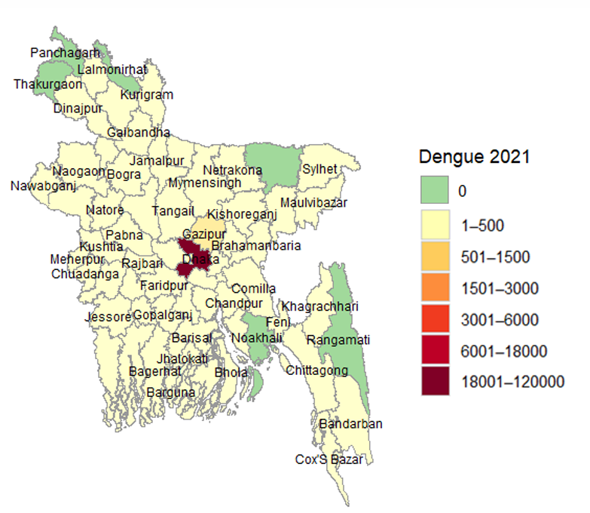
District based spatial distribution of dengue cases in 2020
District based spatial distribution of dengue cases in 2021

Slide 6
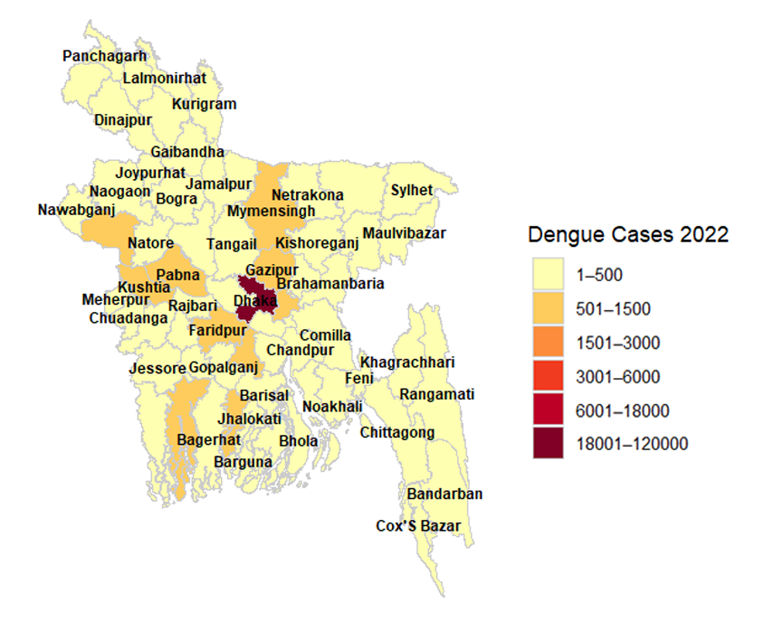
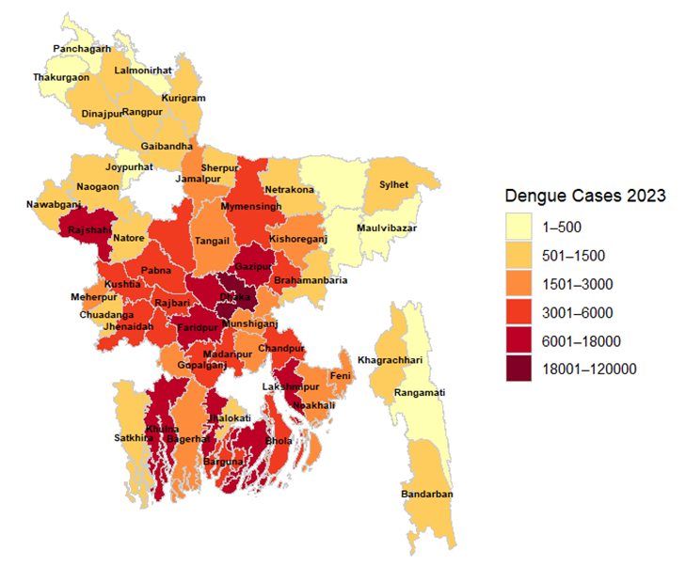
District based spatial distribution of dengue cases in 2022
District based spatial distribution of dengue cases in 2023

Slide 7
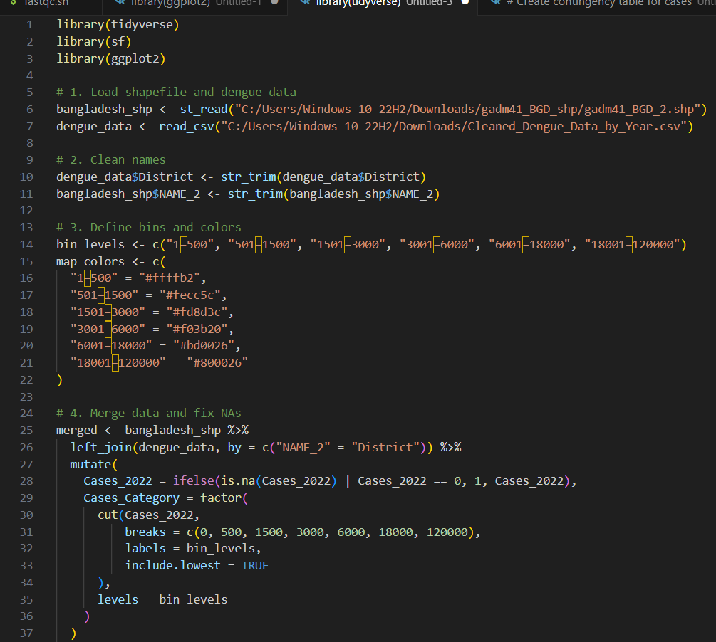
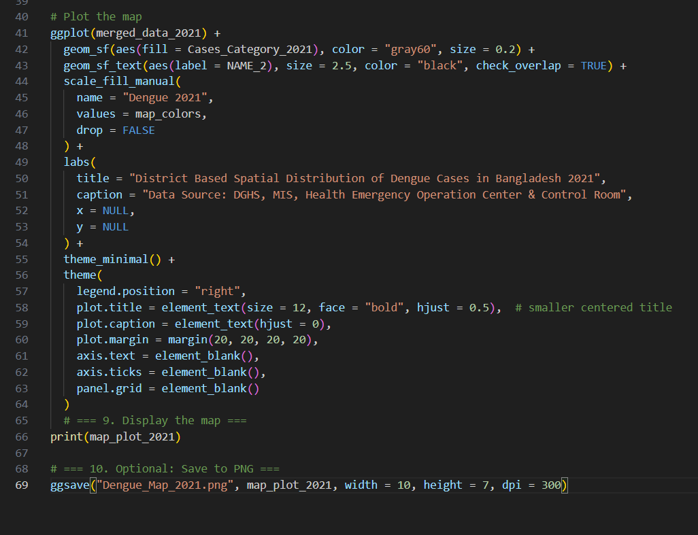

Slide 8
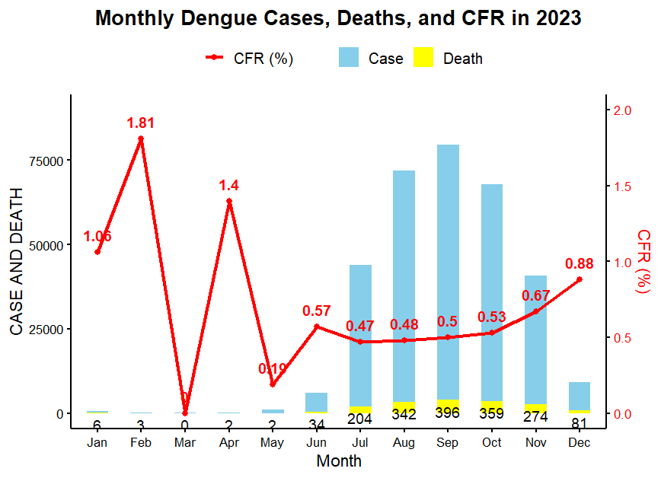

Slide 9
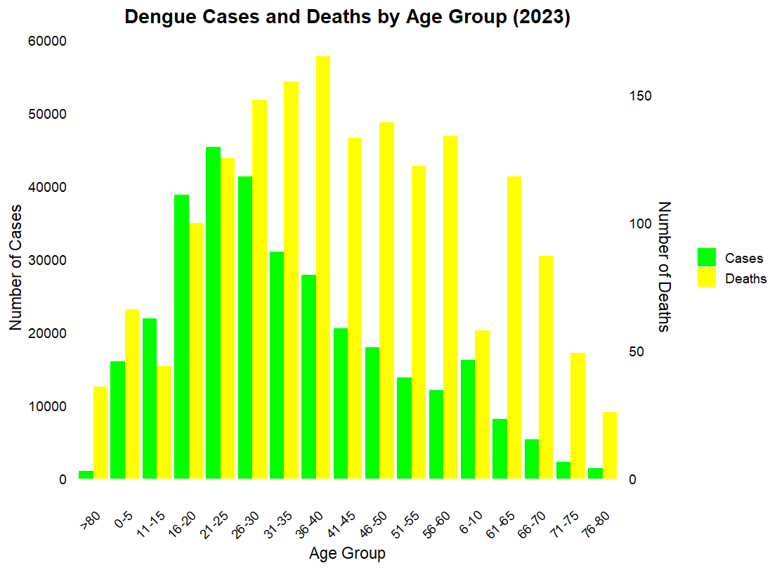

Slide 10
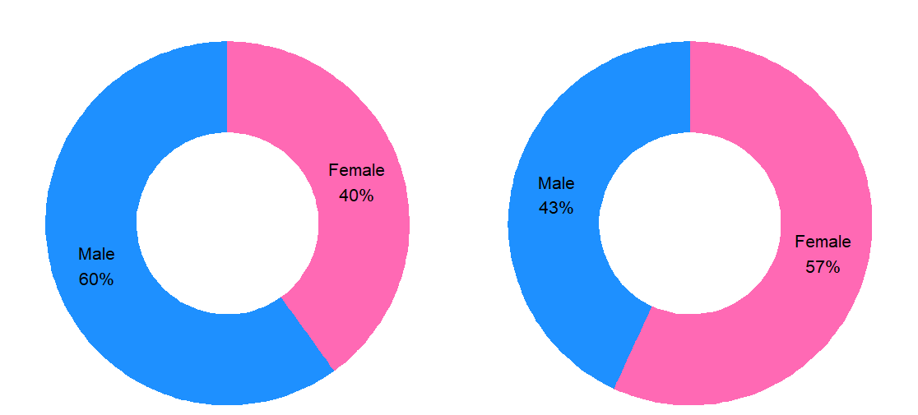
Cases
Deaths
Chi-Square Test : p-value < 2.2e-16

Slide 11
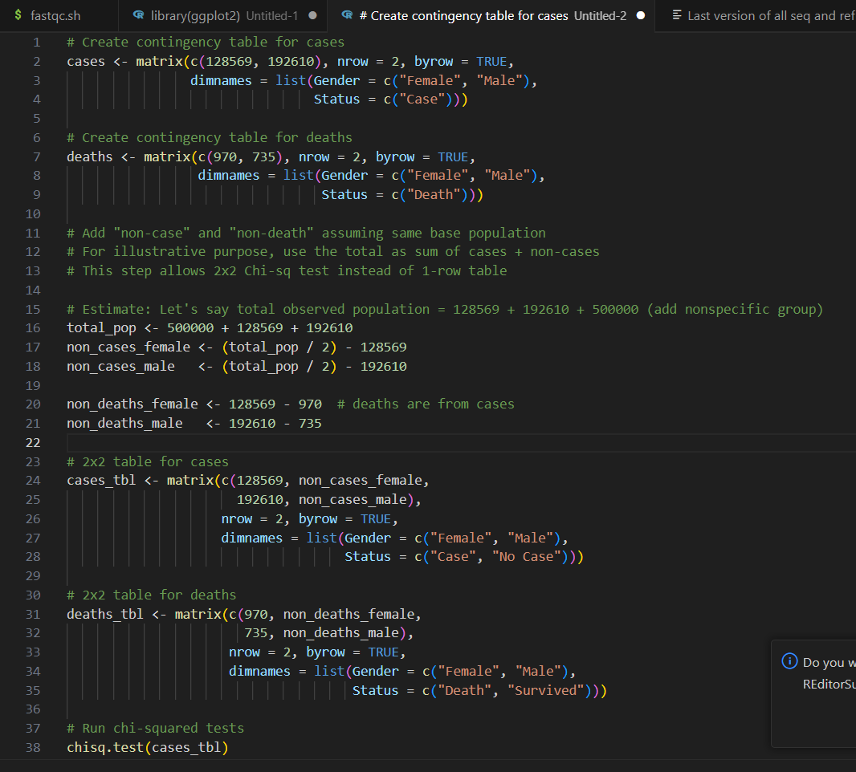

Slide 12
How This Analysis Can Be Useful?
Identify Hotspots: Generates spatial maps and temporal trends to pinpoint districts with high dengue transmission.
Support Timely Interventions: Helps public health officials apply vector control strategies in the right locations at the right times.
Improve Cost Efficiency: Enables data-driven decisions that reduce unnecessary spending on interventions.
Enhance Vector Control: Focused interventions lead to more effective mosquito control and outbreak mitigation.
Demographic Insights: Reveals age- and sex-specific risk patterns, helping to prioritize vulnerable populations for prevention efforts.

Slide 13
References
Salje, H., et al. (2019). Nationally representative serostudy of dengue in Bangladesh. The Lancet Global Health, 7(3), e330-e339. https://doi.org/10.1016/S2214-109X(18)30403-0
Sharmin, S., et al. (2015). Seasonality of dengue in Bangladesh: a time series analysis. PLOS Neglected Tropical Diseases, 9(10), e0004110. https://doi.org/10.1371/journal.pntd.0004110
Karim, M. N., et al. (2021). Epidemiological analysis of the 2019 dengue outbreak in Bangladesh. Tropical Medicine and Health, 49(1), 1–9. https://doi.org/10.1186/s41182-021-00341-z
Morin, C. W., Comrie, A. C., & Ernst, K. (2013). Climate and dengue transmission: evidence and implications. Environmental Health Perspectives, 121(11-12), 1264–1272. https://doi.org/10.1289/ehp.1306556
Hossain, M. S., et al. (2023). Risk factors and spatial distribution of dengue cases in Bangladesh. Scientific Reports, 13, 11340. https://doi.org/10.1038/s41598-023-38573-7

Slide 14

Questions?

